Slide 1

Techniques for Multi-Standard Cognitive Radios on FPGAs
PhD Oral Defense
Pham Hung Thinh
School of Computer Engineering
Supervised by
Asst. Prof. Suhaib A Fahmy
Co-Supervised by
Prof. Ian McLoughlin
Joint TUM Supervisor:
Prof. Samarjit Chakraborty

Slide 2




OUTLINE
Research Introduction
Motivation
Objectives
Contributions
Background Literature
Research Contributions
Conclusions and Future Work
Notes:
This is presentation outline.
Firstly, I will present the …
Secondly, Background Literature is considered …
Then, I will discussed ….
Finally, …

Slide 3
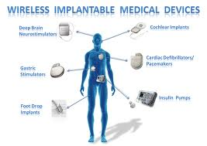


Research Introduction
Wireless Applications
Mobil Communication
Vehicle Communication
Notes:
Nowadays, The wireless applications are developed rapidly to make the social life better.
Mobil Com
Car Com.
Health Care System…
It also raises many challenges.
It’s requires a low-power design.
highly adaptive, robustness against changing environment
Particularly, Spectrum is limited resource that require … dynamic spectrum access to ...

Slide 4
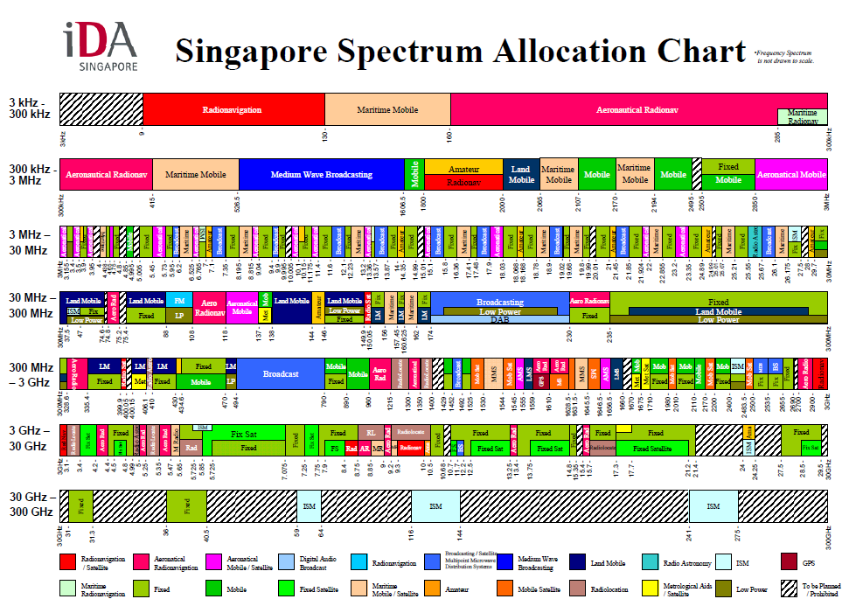
Research Introduction
Lack of spectrum
Source: http://www.ida.gov.sg/ (16-July-2012)
Notes:
The Chart shows …
The spectrum resource …
The dedicated frequency band is not always used at any time or any where.
This motivate our project for developing Cognitive radios.

Slide 5
Research Introduction
Low power system
WiFi(802.11)
WiMax(802.16)
Multi-Standard
Cognitive Radios
(MSCR)
LTE
Efficient Spectrum Usage
Adaptation
WRAN(802.22)
Notes:
CR emerges to be a suitable solution.
CR Systems sense …, learn and adapt to improve …..
For further flexibility, Multiple Standard Cognitive Radios is defined with the agility to operate in multiple frequency bands.
Frequency band -> corresponding standards.
MSRC is a more flexible generalisation of CRs.

Slide 6
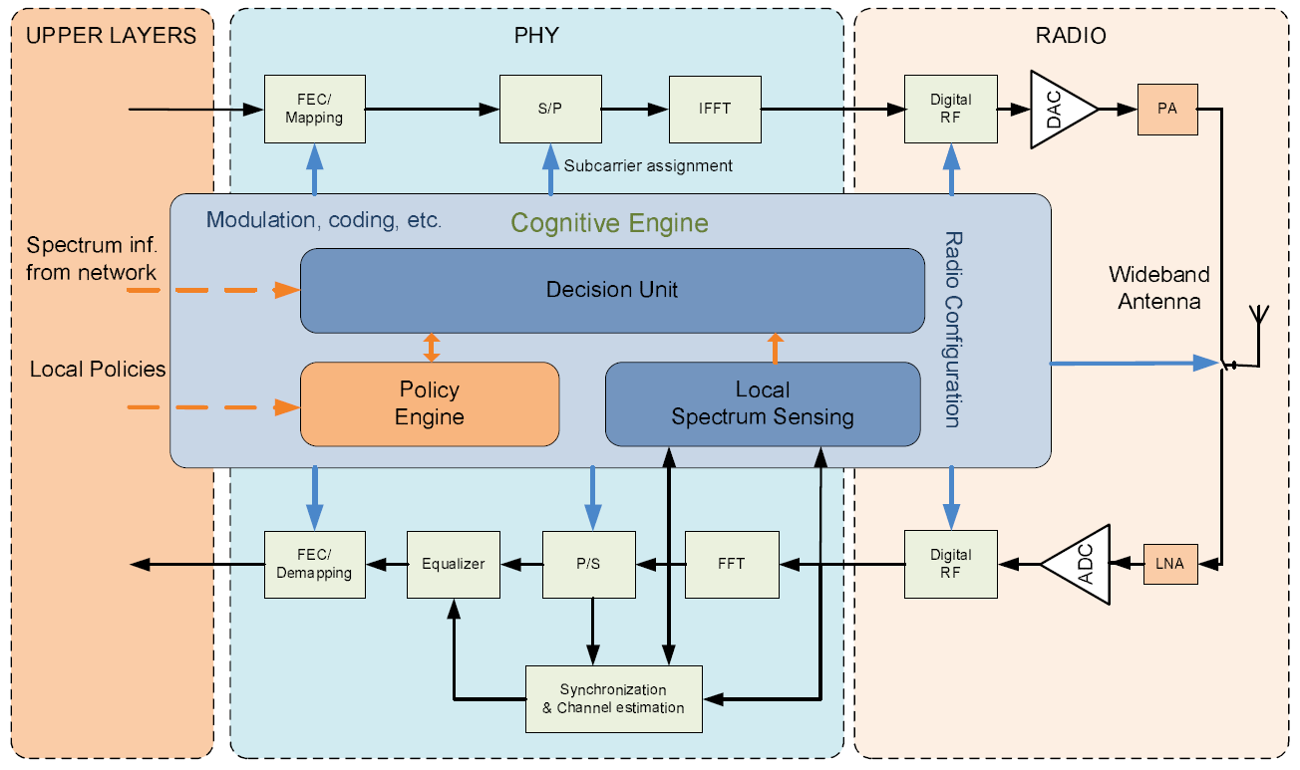
Research Introduction
Research Objective:
Our research focuses on low power physical layer for Multi-Standard CRs for high performance and flexibility.
PHYSICAL LAYER
Source: Mahmoud et. al., OFDM for Cognitive Radio: Merits and Challenges, IEEE Wireless Communication, vol.16, no.2, pp.6-15, April 2009.
Notes:
The Figure shows …
It includes components …
Explain the Figure …
These Components must …
Our research focuses …
Orthogonal Frequency Division Multiplexing ….

Slide 7

Research Introduction
Research Objectives:
Enhanced OFDM Synchronisation
Dynamic Spectral Leakage Filtering
Architecture for Standard Agility and Reduced Configuration Time
Notes:
OFDM has intrinsic … .
We present novel enhanced synchronisation methods for.
Secondly, OFDM normally has large spectral leakage …
We research on …
The crutial objective …
We will explain all of these later.

Slide 8
Research Introduction
Research Contributions:
A multipilerless correlation technique for OFDM timing synchronisation.
(1) T. H. Pham, S. A. Fahmy, and I. V. McLoughlin, “Low-power correlation for IEEE 802.16 synchronisation on FPGA," in IEEE Transactions on Very Large Scale Integration (VLSI) Systems, vol. 21, no. 8, pp. 1549 – 1553, Aug. 2013.
A novel OFDM synchronisation method combining robust performance with computational efficiency
(2) T. H. Pham, I. V. McLoughlin, and S. A. Fahmy, “Robust and Efficient OFDM Synchronisation for FPGA-Based Radios,” in Circuits, Systems, and Signal Processing, vol. 33, no. 8, pp. 2475 - 2493, Aug. 2014, Springer.
A novel IFO estimation technique that reduces both the power and computational cost in OFDM implementations.
(3) T. H. Pham, S. A. Fahmy, and I. V. McLoughlin, “Efficient Integer Frequency Offset Estimation Architecture for Enhanced OFDM Synchronisation,” accepted for IEEE Transactions on Very Large Scale Integration (VLSI) Systems, to appear 2016.
Notes:
This thesis has the contributions at a platform level, algorithm level and signal processing techniques to create a general OFDM-based architecture with a high level of adaptation and parameterisation on FPGA.
For enhance the synchronisation, we proposed three novel techniques that are published or accepted in two IEEE transaction and one Springer journal.

Slide 9
Research Introduction
Research Contributions:
A novel filtering scheme for adaptively shaping the spectral leakage of OFDM signals.
(4) T. H. Pham, I. V. McLoughlin, and S. A. Fahmy, “Shaping Spectral Leakage for IEEE 802.11p Vehicular Communications," in Proceedings of IEEE Vehicular Technology Conference (VTC Spring), Seoul, Korea, May 2014.
(5) T. H. Pham, S. A. Fahmy, and I. V. McLoughlin, “Spectrally Efficient Emission Mask Shaping for OFDM Cognitive Radios,” under 2nd round review for Digital Signal Processing Journal.
A system-level approach for designing multi-standard radios on FPGAs.
(6) T. H. Pham, S. A. Fahmy, and I. V. McLoughlin, “Efficient Multi-Standard Cognitive Radios on FPGAs," PhD Forum Poster in Proceedings of the International Conference on Field Programmable Logic and Applications (FPL), Munich, Germany, September 2014.
(7) T. H. Pham, S. A. Fahmy, and I. V. McLoughlin, “Efficient OFDM-based baseband processing for Multi-Standard Cognitive Radios on FPGAs," in preparation for submission to ACM Transactions on Embedded Computing Systems.
Notes:
In addition, We present a novel filtering scheme for shaping the spectral leakage of OFDM signals.
The method proposed in this research is the first implementation technique that can achieve the specification for the most stringent SEM of 802.11p and 802.11af.
We propose a system-level approach to design a multi-standard radios on FPGAs.
We will discuss all of these contributions in a subsequent section.

Slide 10
OUTLINE
Research Introduction
Background Literature
Cognitive Radios
OFDM
FPGAs
Contributions
Conclusions and Future Work
Notes:
We have now brief review on literature.

Slide 11

Cognitive Radios
Software Defined Radios (SDR): a flexible platform for implementing specific radio systems.
Cognitive Radio (CR): an evolution of SDR in adapting the radio to a changing environment.
Multi-Standard Cognitive Radio (MSRC): operate in multiple frequency bands with different specified standards, providing greater flexibility.
Notes:
Software Defined Radios are radio communication systems in which the processing components are realised by means of software on a computer or embedded system instead of in hardware circuits. SDR provides a flexible platform on which application specific radio systems can be implemented.
Cognitive Radio (CR) is an evolution of SDR incorporating intelligence in adapting the radio to a changing environment.
Require Powerful Computational Computer Platform.
Recently, CR has gained further importance due to spectrum scarcity and inefficient spectrum usage.
CRs enable a situation where spectrum allocated to licensed users, known as Primary Users, can be reused by unlicensed users,
referred to as Secondary Users, when the Primary Uses are not using it.
Apart from the critical issues of sensing for unused spectrum and allocating bands for transmission, the lower priority of SUs presents a problem in terms of transmission capability and quality of Service.
If the spectrum bands allowed for a CR are fully occupied by Primary Uses and other users transmission might be blocked.
Multi-standard cognitive radios can operate in multiple frequency bands providing greater flexibility.

Slide 12
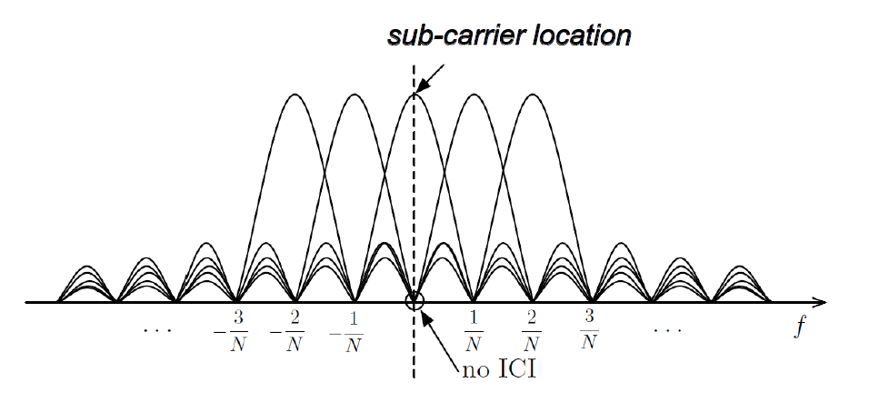
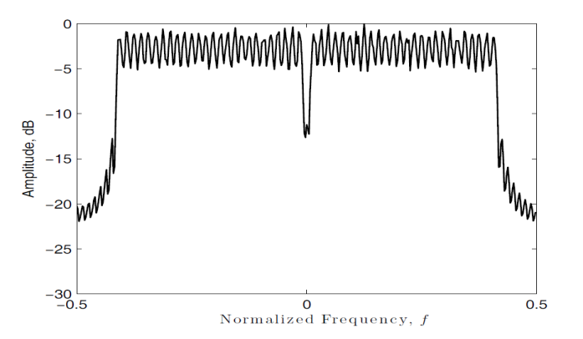
Orthogonal Frequency Division Multiplexing (OFDM)
OFDM is a multicarrier modulation scheme; a high-rate data stream is split into multiple parallel low rate streams.
The adjacent sub-carriers are orthogonal and have no Inter carrier Interference (ICI).
OFDM signals are modulated using sub-carriers across different frequencies
Notes:
OFDM is a multicarrier modulation scheme…
The figure below shows the sub-carriers in frequency domain and the spectrum of OFDM signal.
Explain no ICI…
Explain main spectrum, side lobe…

Slide 13
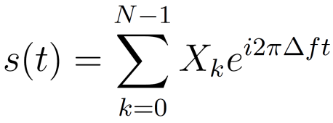
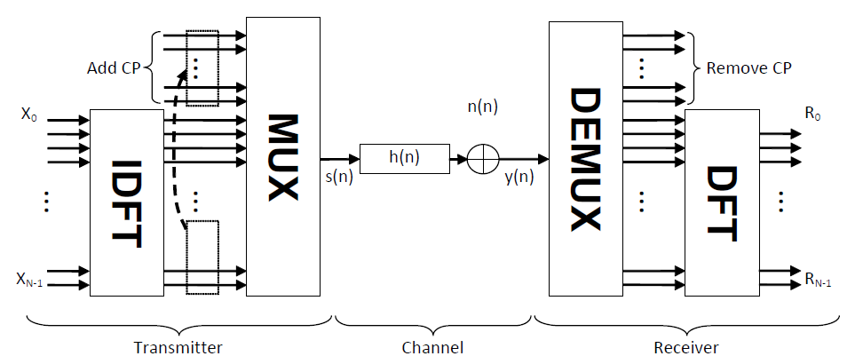
OFDM
An OFDM symbol signal can be expressed at baseband as a sum of modulated complex exponentials as:
OFDM symbol signal is modulated by an inverse N-point discrete Fourier transform (IDFT)
Inversely, the sampled OFDM symbol signal can be demodulated using discrete Fourier transform (DFT).
Notes:
The below diagram shows the concept of OFDM implementation by using IDFT and DFT.

Slide 14
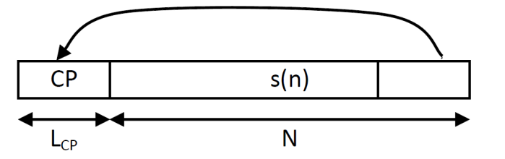
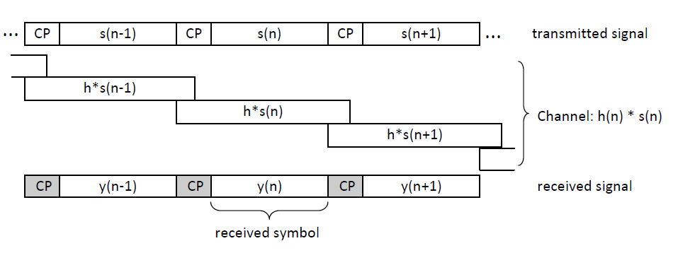
OFDM
A guard interval (or cyclic prefix (CP)), having a length of L_{CP} is added before each OFDM symbol.
The length of CP must be longer than that of the channel impulse response (CIR) to avoid Inter Symbol Interference (ISI).
Notes:
A guard interval is added before each OFDM symbol to avoid ISI.
The first Fig. shows how the CP is added
Explain avoiding ISI

Slide 15

OFDM
Evaluating OFDM :
Spectrally efficient usage
Robustness against multipath propagation
Perfect cancellation of ISI and ICI thanks to CP
Robustness against fading thanks to splitting a data stream into several parallel low-rate streams
Easy implementation using fast Fourier transform (FFT)
Notes:
OFDM has many advantages such as:
Efficient spectral usage
Robustness against multipath propagation
Easy implementation using Fast Fourier transform

Slide 16
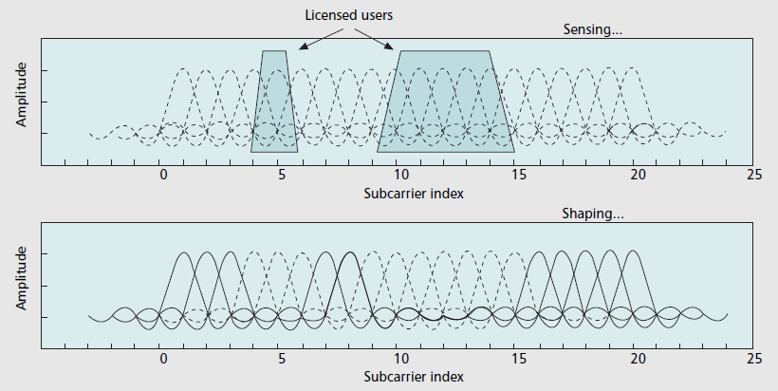
OFDM
Good fit for CR:
Performing spectrum sensing and awareness effectively
Doing spectrum shaping easily with Non-Contiguous OFDM (NC-OFDM)
Ability to change parameters for adaptation/ scalability
Notes:
Graph explain sensing and shaping

Slide 17

OFDM
OFDM Synchonisation
Sensitive to synchronization performance.
Frequency offset causes inter-carrier interference (ICI)
Timing offset can lead to inter-symbol interference (ISI).
Notes:
OFDM performance is very sensitive to synchronization.
Frequency offset causes inter-subcarrier interference(ICI).
Timing offset can lead to inter-symbol interference (ISI).

Slide 18

OFDM
OFDM Synchonisation
Terminology
Timing offset (STO) refers to differences in correct sample index and the actual sample index of received sample that causes misaligned window to compute DFT for demodulation.
Coarse STO estimation is to find the starting index of OFDM symbol inside the received OFDM symbol including CP.
Fine STO estimation is to find the accurate index to obtain correct OFDM symbol’s samples to compute DFT for demodulation.
Carrier frequency offset (CFO) refers to a difference in frequency between the receiver clock with respect to the ‘correct’ frequency of carriers in a transmitted OFDM symbol.
CFO is commonly normalized by the sub-carrier frequency. The integer CFO (IFO) represents shifted subcarrier symbols in the frequency domain, while the fractional CFO (FFO) causes the interference between subcarriers
Notes:
There are some terminology be commonly used for OFDM synchronisation.
Timing Synchronization estimate the starting point to sample the received signal
Frequency Synchronization estimate the frequency mismatch between TX and RX

Slide 19

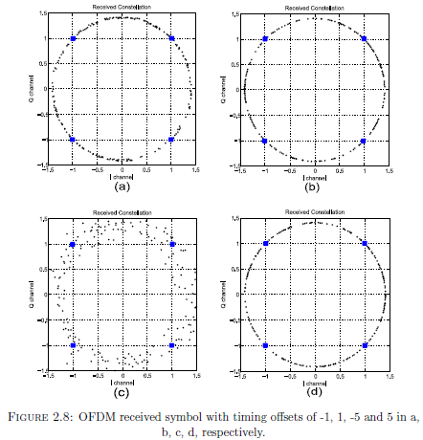
OFDM
OFDM Synchonisation
Timing offset refers to differences in correct sample index and the actual sample index of received sample.
Actual sample index is earlier than correct sample index leading to subcarrier rotation.
Actual sample index is later than correct sample index resulting in ISI.
Notes:
The graphs show the effects of timing offset on data symbols.
Explain graph…
Timing offset may result in the carrier rotation or ISI.

Slide 20
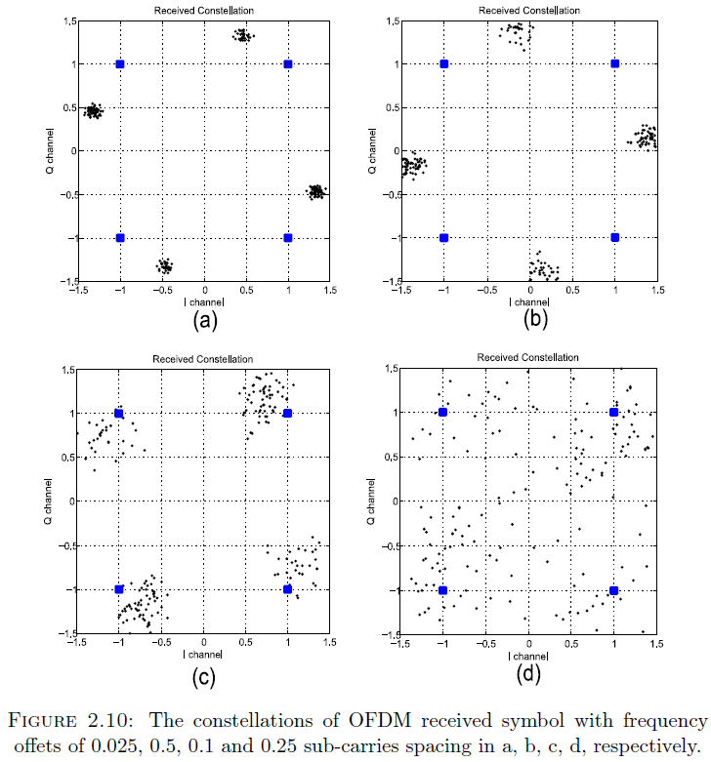
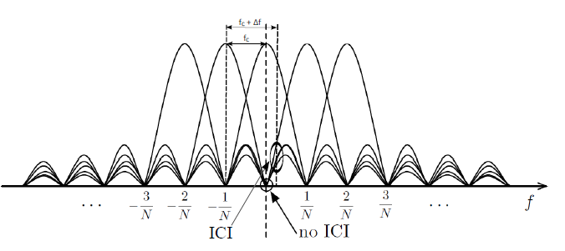
OFDM
OFDM Synchonisation
Frequency offset introduces the loss of orthogonality between the sub-symbols, significantly degrades system performance
Notes:
Explain graph ICI.
OFDM performance is sensitive to even small frequency offsets.
The effect of CFO causes dispersion and also phase rotation in the QPSK constellation.

Slide 21

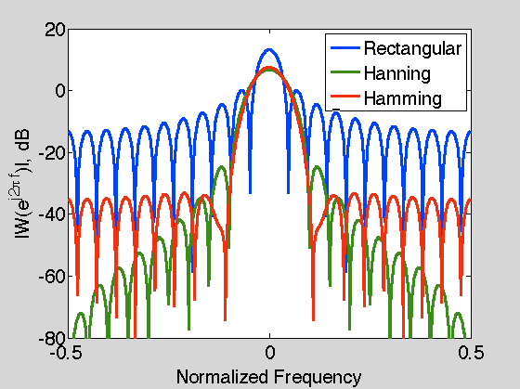
OFDM
OFDM has large spectral leakage
Applying window filter can reduce side lobes of OFDM signals
Notes:
One another drawback of OFDM is spectral leakage due to the summation of sinusoidal subcarriers.
The graph shows the spectrum leakage of some window filter applied for ODFM symbols.
Explain graph…
Defaul is Retangular window
Windowing can reduce side lobes of OFDM signals.

Slide 22

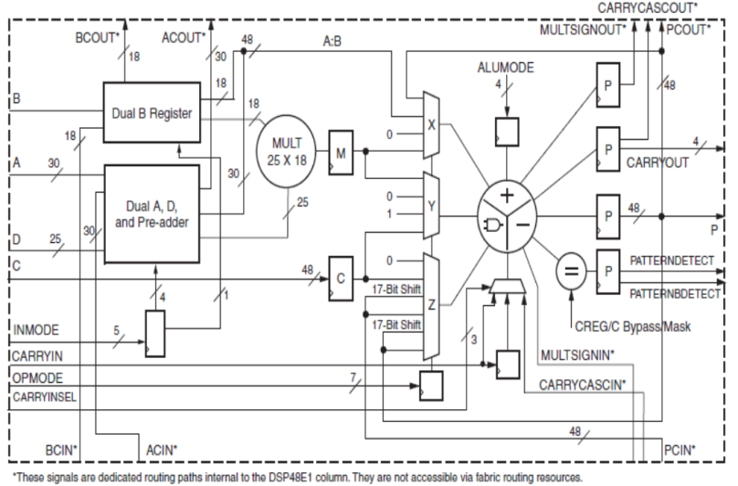
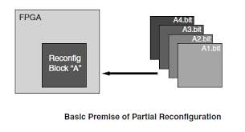
Field Programmable Gate Array (FPGA)
FPGAs are an attractive platform for digital circuit implementation in particularly for CR research.
High performance
Low power
Flexibility
DSP 48: Powerful hard IP core
Partial Reconfiguration
Notes:
High Performance, low power architecture, flexible reconfiguration make FPGAs an attractive platform for digital circuit implementation in particularly for CR research.
DSP …
PR … dynamic and short time recog…

Slide 23
OUTLINE
Research Introduction
Background Literature
Research Contributions
Multiplierless Correlator Design
OFDM Timing Synchronisation
OFDM IFO Estimation Method
Spectrum Efficient Shaping Method
Architecture for Multi-Standard CRs
Conclusions and Future Work
Notes:
The thesis presents 5 main contributions:

Slide 24
Research Contribution on
Multiplierless Correlator Design

Slide 25

Multiplierless Correlator Design
Correlation commonly to perform synchronisation
Cross-Correlation better than Auto-Correlation, come at hardware cost
Multiplierless-Correlation reduces complexity, power
Notes:
Correlation is …
The accuracy of cross-correlation …
Multiplierless Correlator …

Slide 26

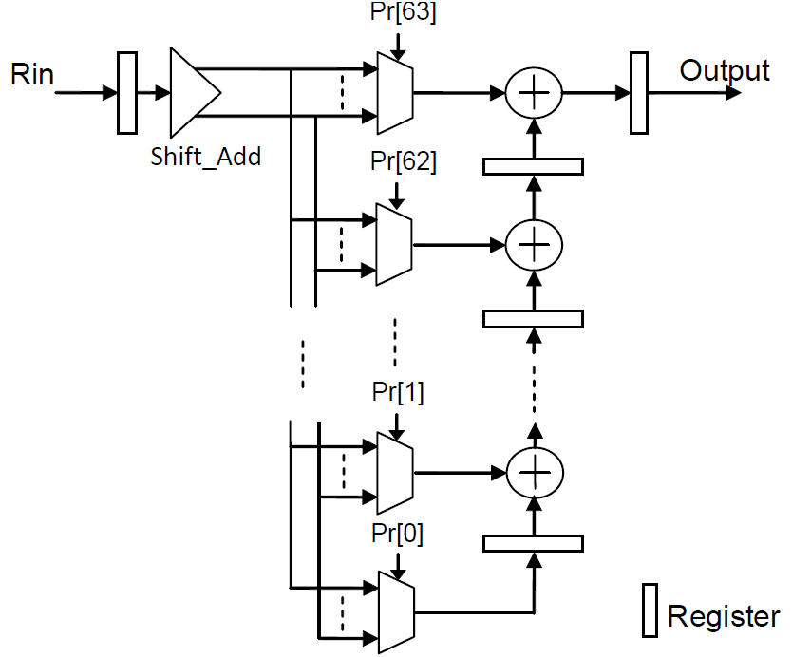
Multiplierless Correlator Design
DSP48 used as multiplier for Correlation operation
Coefficients are rounded in the form of summed powers of two.
Shift, Add instead of multiplying by coefficients.
Four alternative multiplierless Correlation with 4 coefficient sets
Quantisation of 0.125, 0.25, 0.5, and 1 corresponding to using 4, 3, 2, 1 bits .
Notes:
Conventionally, DSP 48 … a large amount DSP48
We present a structure for multiplierless correlation to overcome the challenge of resource efficiency.
The principle of multiplierless correlators …
In this investigation, four alternative multiplierless correlators …
The coefficient sets are determined by ….

Slide 27
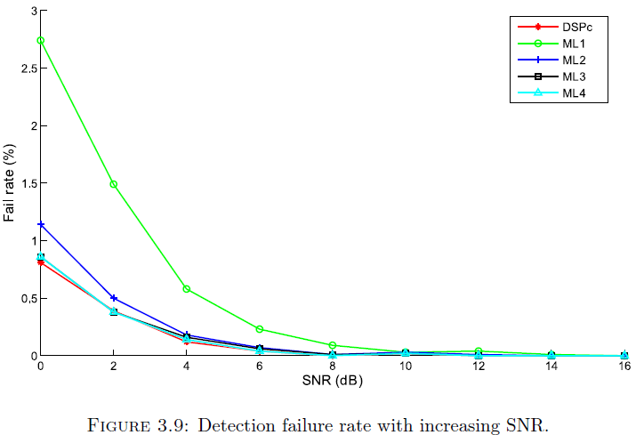
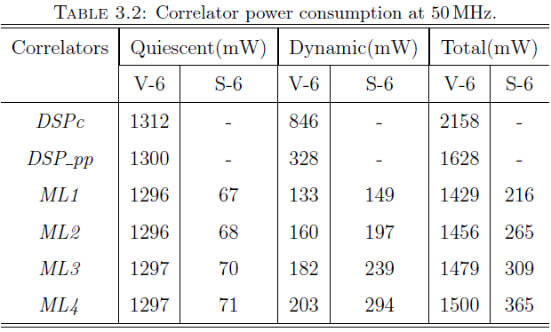

Multiplierless Correlator Design
Multiplierless Correlation Results
Sufficient DSP Blocks on large Virtex but not Spartan
ML Cor save over 85% power compared to a DSP based design
SNR: Signal to Noise Radio
DSPc : DSP48 based correlation
ML1, …, ML4: Multiplierless correlator with quantisation of 1, 0.5, 0.25, 0.125
Published in TVLSI
Notes:
The graph shows …
ML2, ML3, ML4 and DSP …
Table reports …
Multiplierless correlation consumes less power than DSP48 based correlation.
Moreover, low-cost devices such as the Xilinx Spartan-6 do not include sufficient DSP48 blocks for multiplier-based correlation.
ML2 on a Spartan-6 can save over 85% power compared to a DSP-based design on a Virtex-6 FPGA.
This work has published in TVLSI. We have 9 citations for this publication.

Slide 28
Research Contribution on
OFDM Timing Synchronisation

Slide 29
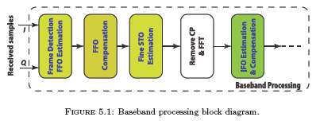
OFDM Timing Synchronisation
OFDM synchronisation obtained by performming the correlation on the CP or the preamble symbols of OFDM frame.
Auto-correlation vs Cross-correlation.
New timing metrics take advantage of preamble characteristics (periodic, energy distribution)
Efficient implementation using Multiplierless correlation to estimate timing offset and Fractional CFO.
Published in Circuits, Systems, and Signal Processing journal
Notes:
Explain the place where Synch is performed…
OFDM synchronisation is typically realised by performming ….
Preamble symbols are …
Auto-correlation …
We propose a new ….
We also present an efficient architecture for implementing the synchronisation method to achieve the hardware cost reduction while maintain good performance

Slide 30
Research Contribution on
OFDM IFO Estimation Method

Slide 31
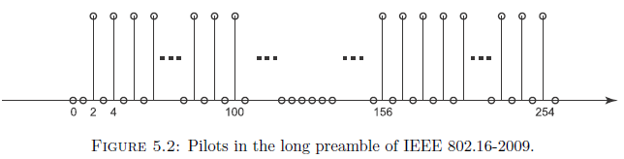
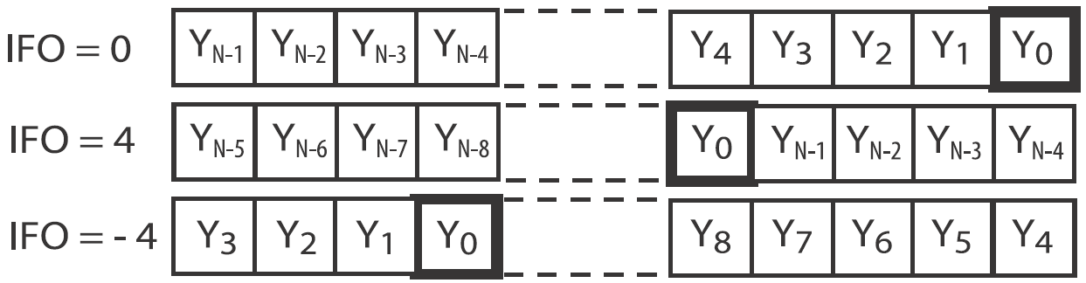
OFDM IFO Estimation Method
Robust IFO Estimation: relax analogue RF constraints, reduced cost.
Notes:
Previously, robust OFDM timing synchronisation was explored to perform well even in the case of large fractional CFO.
However, the CFO estimation of that method was only estimate the fractional CFO.
The large integer CFO may be presented as a result of the Doppler Effect and/or due to local oscillator instabilities.
IFO causes a circular shift of the subcarrier in the frequency domain.
Cross Correlation is the formula of the conventional IFO estimation consumes a huge computational cost, is not practical for hardware implementation.

Slide 32

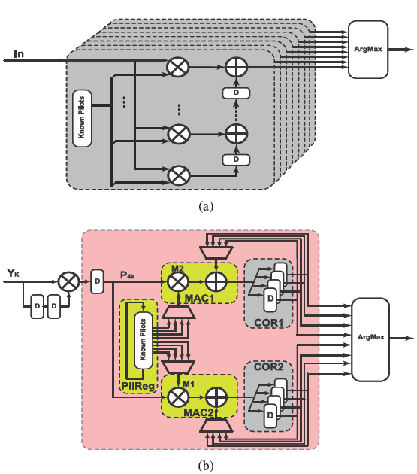
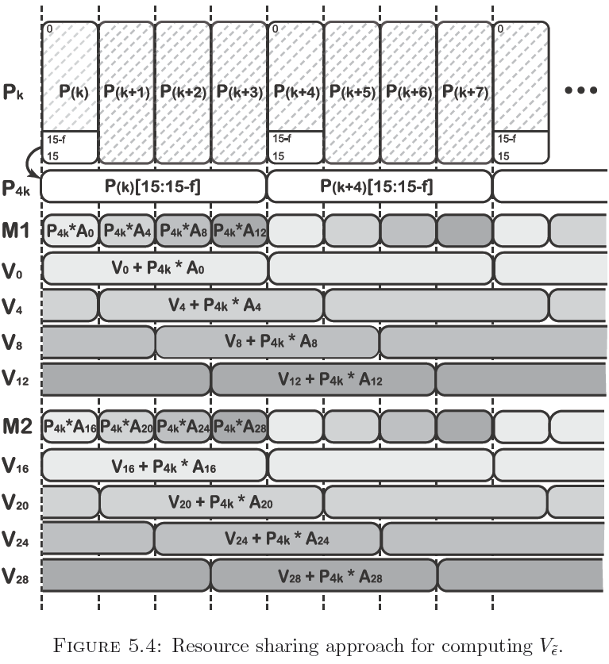
OFDM IFO Estimation Method
A low power, low resource utilisation implementation
Notes:
Explain calculation scheme and resource sharing architecture

Slide 33
OFDM IFO Estimation Method
Four-fold resource sharing architecture to reduce hardware cost;
ML Correlation with optimised wordlength improve accuracy
Dynamic power consumption is reduced by 78%;
accurate estimation in both AWGN and frequency selective channels
Accepted for publication in IEEE TVLSI
Notes:
The proposed implementation is an four-fold resource sharing architecture to significantly reduce hardware cost.
The method maintains the performance as well as current state-of-the-art methods that employ multiplier-based correlation, but significantly improve power efficiency and reduce hardware cost
Compared to the sig-bit state of the art implementation, the proposed method present a power reduction by 78% and offers better estimation performance in both AWGN and frequency selective channels.

Slide 34
Research Contribution on
Spectrum Efficient Shaping Method
Notes:
This contribution present a novel method is proposed to perform spectral leakage filtering within a cognitive radio (CR) architecture.

Slide 35
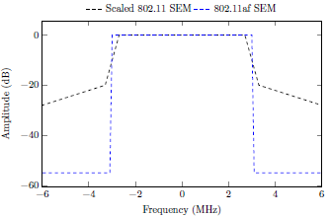
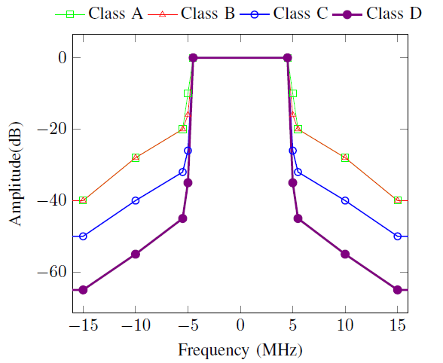
Spectrum Efficient Shaping Method
802.11p defined for vehicular channels
802.11af defined for reuse Television white space
Pulse Shaping & FIR Filtering for shaping spectral Leakage
SEMs: spectral emission masks
Notes:
802.11p is an amendment …
802.11af is ….
The graphs show ….
SEM is spectral emission marks. SEM is defined …
Pulse shaping…

Slide 36
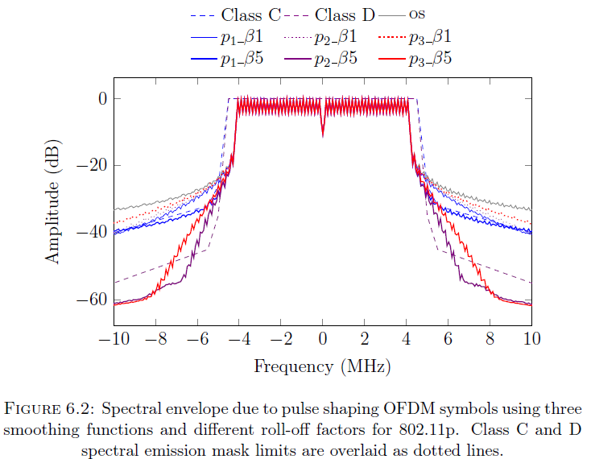
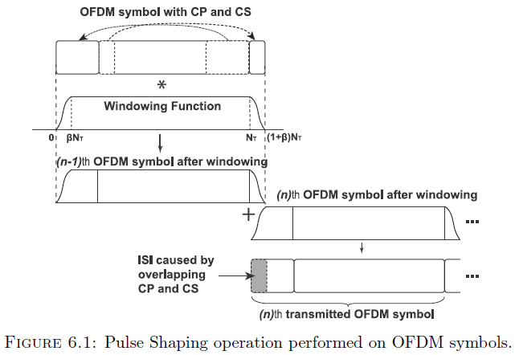
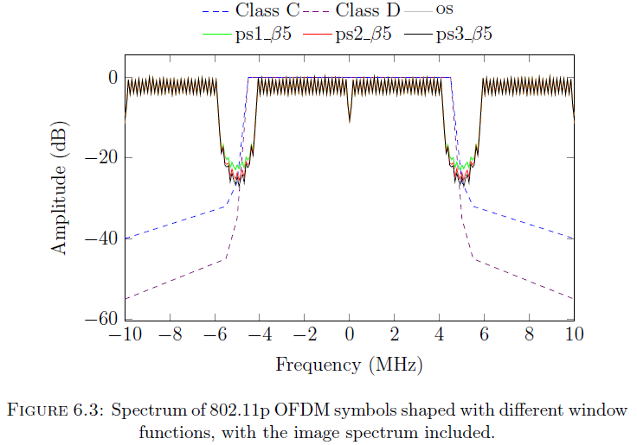
Spectrum Efficient Shaping Method
Pulse Shaping & FIR Filtering
Notes:
The left figure shows the realisation of pulse shaping.
Explain the graph…
The investigation on three popular pulse functions are shown in the graph on the righ-hand side.
Explain the graph…
The pulse shaping does not help to cancel image spectrum.

Slide 37
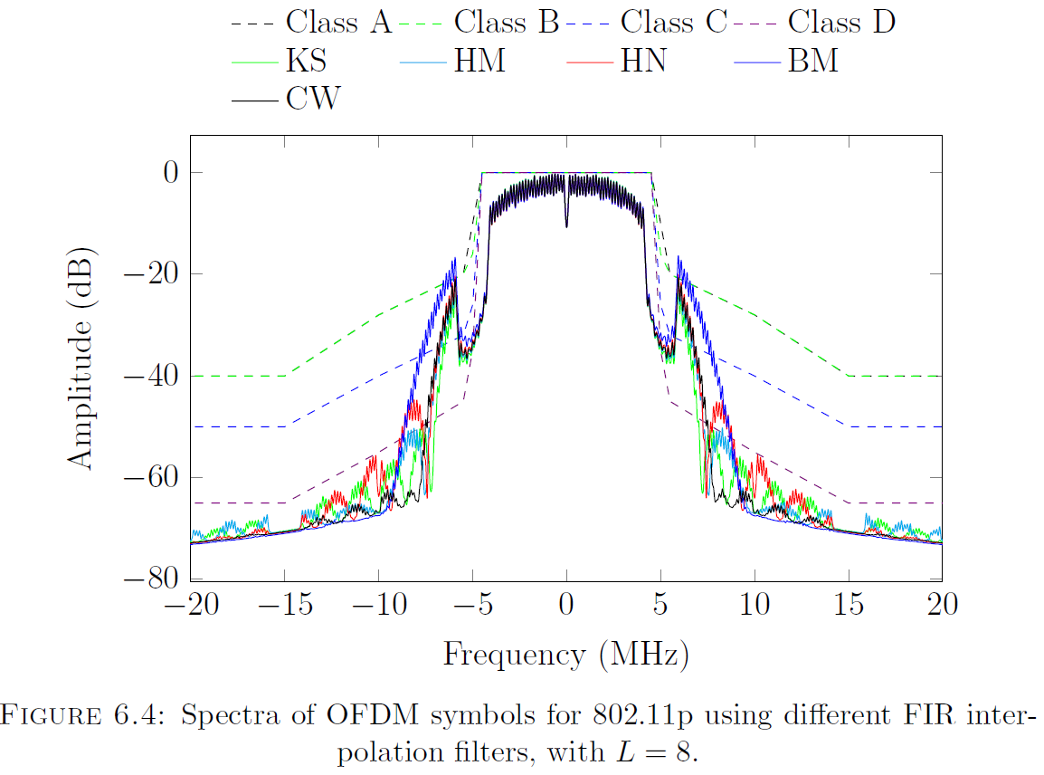
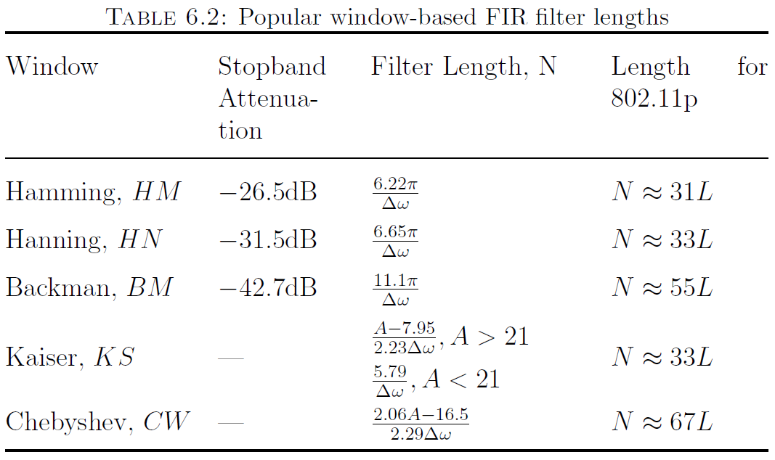
Spectrum Efficient Shaping Method
FIR Filtering
Notes:
FIR filter can be used to cancel image spectrum.
There are many FIR filter be investigated.
The results for shaping spectral leakage for 802.11p signals are plotted in the righ graph.
Explain the graph…
It is impossible to satisfy the most stringent SEMs, because the filters have the limited length due to the guard interval.

Slide 38
Spectrum Efficient Shaping Method
Pulse shaping with large roll-off factors and wide frequency guard have significant side lobe compression
Wide frequency guard extends the transition band
=> shorter filter
=> Demand a frequency guard extension technique
Notes:
We have the observation that:
Pulse shaping …
Wide frequency guard …
We need…

Slide 39
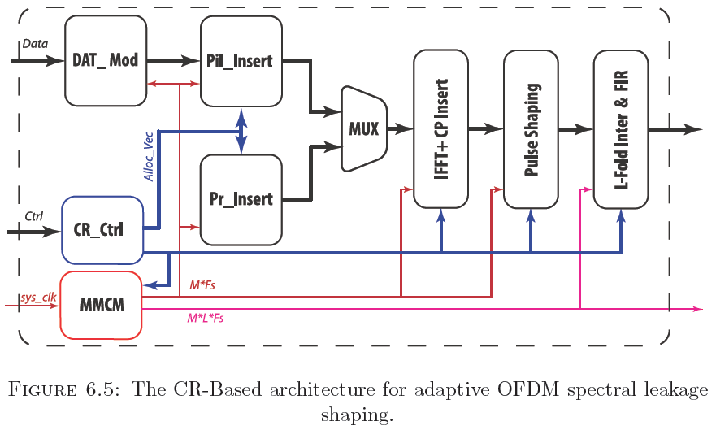
Spectrum Efficient Shaping Method
Increase IFFT Length, Sampling (M times); (MMCM)
Employ allocation vectors (CR_Ctrl)
Pulse shaping is applied with large roll-off factor
L-fold inter and FIR filter remove the image spectrum.
Notes:
The graph below shows the block diagram performing proposed filter.
The proposed method are performed in the three following steps:
First, Frequency guard is extended. The IFFT length and the sampling frequency are increased by M times.
MMCM module generate the higher clock rate.
The subcarriers maintain the same spacing.
The allocation vector is formed to add data symbols at same subcarriers in the original signal.
The remaining subcarriers are zero-padded to extend the frequency guard.
Next, pulse shaping is applied with large roll-off factor in the normal way, to meet the given SEM constraint.
Finally, L-fold interpolation and FIR filter are used to allow simple filtering to remove the image spectrum.

Slide 40
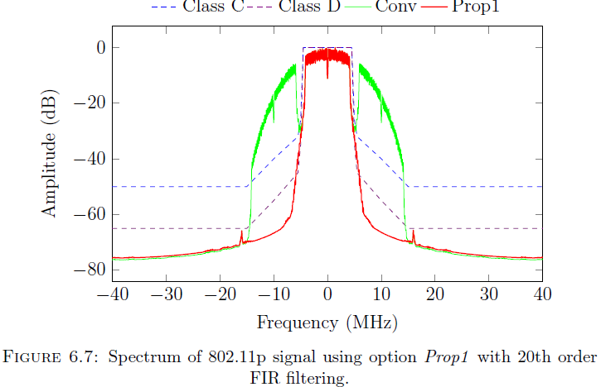
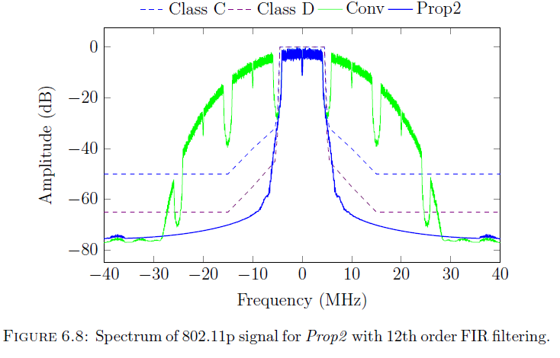
Spectrum Efficient Shaping Method
Configuration and Performance Evaluation for 802.11p
Prop1: double IFFT size (M = 2); 4-fold interpolation (L = 4); Fs=80 MHz.
=> GI usage: 500 ns for PS; 500ns for FIR and matched filter; 600ns for CIR
Prop2: 4 x IFFT size (M = 4); 2-fold interpolation (L = 2); Fs=80 MHz.
=> GI usage: 500 ns for PS; 300ns for FIR and matched filter; 800ns for CIR
Conv : Conventional method
Notes:
We investigate the application of the proposed method to filter the signal of two recent standards 802.11p, 802.11af.
For realisation of 802.11p.
There are two alternative configuration of proposed methods be listed here.
The graph show the shaped spectrum of proposed method can be fitted in the stringent SEMs.
Conventional method using only FIR filter.
Explain graph…

Slide 41
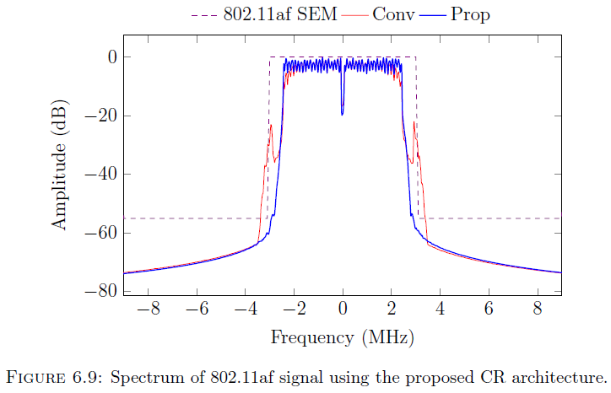
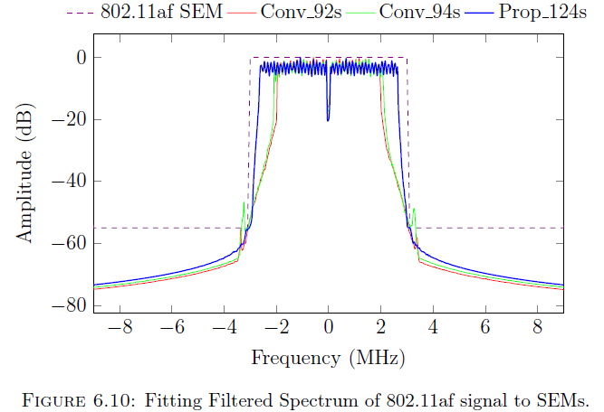
Spectrum Efficient Shaping Method
Configuration and Performance Evaluation for 802.11af
BW = 6MHz: 4xIFFT size (M = 4); 2-fold interpolation (L = 2); Fs = 48 MHz.
=> GI usage: 3.75 ns for PS; 1.12ns for FIR and match filter; 1.13ns for CIR
Notes:
For the realisation of 802.11af, the configuration is reported here
The graph on the left hand side shows the results of filtering.
Explain graph … The proposed method totally fits in the SEM. The conventional method has two side glitch that violate the SEM
We further investigate on spectral efficiency of proposed method relied upon given a flexible allocation of subcarriers.
Explain graph… Adjusting the number of occupied subcarriers until the transmission spectrum fits within the 802.11af SEM.
The results shown in the graph on the right hand side, to fit in the SEM, the proposed method allows employing 124 sub carriers while that is 92 subcarriers in conventional methods

Slide 42
Spectrum Efficient Shaping Method
CR architecture for shaping spectral leakage at baseband
Meet stringent SEMs of 802.11p, 802.11af
Achieve spectral efficiency for reuse of TVWS in 802.11af by 32%,
This work is reported in VTC 2014 and extended for DSP journal
Notes:
This contribution can be summarized here.
Shaping the OFDM leakage spectrum has been investigated at baseband within a CR architecture to relax RF-Front End filtering.
Simulations show that the proposed architecture can meet the specification of the four 802.11p classes A to D, as well as the stringent for 802.11af in the TV white space band.
The proposed method is also shown able to improve the achievable spectral efficiency for reuse of Television White Spaces in the 802.11af standard by 32 compared to conventional approaches
In addition, the architecture has the ability to adaptively change the degree of spectral leakage filtering in response to transmission power.
This work is reported in VTC 2014 and the extension is revised for DSP journal

Slide 43
Research Contribution on
Architecture for Multi-Standard CRs

Slide 44
Architecture for Multi-Standard CRs
MSCR for the demand: higher bandwidth, efficient spectrum usage
FPGAs: ideal platform for flexibility, performance, and efficiency.
The reconfiguration: fast to prevent suspending data processing
Notes:
Multi-Standard CRs operating on …. are becoming more attractive for ….
FPGAs offer an ….
We can incorporate our contributions in previous chapters into a flexible architecture for multi-standard cognitive radios.
The reconfiguration needs to be …

Slide 45
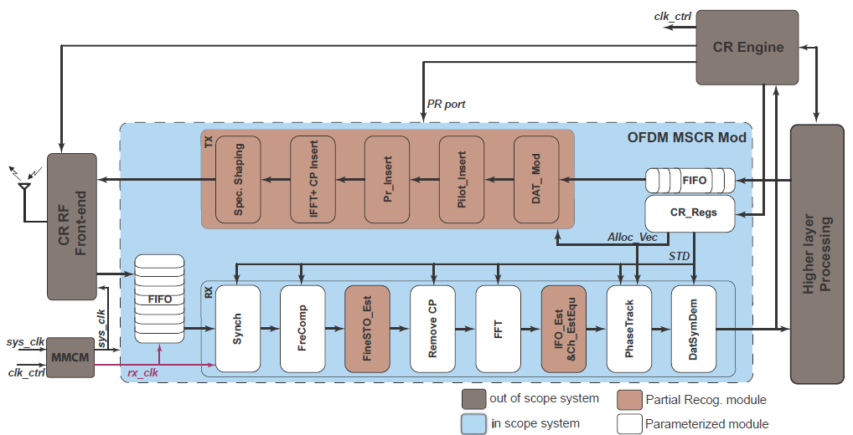
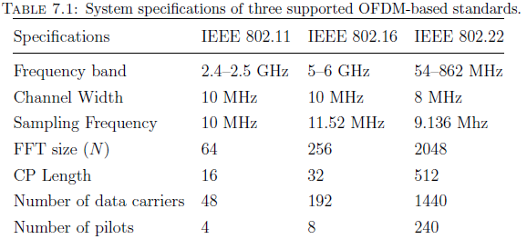
Architecture for Multi-Standard CRs
Control plane and Data plane
Flexibility of switching baseband
Stream processing.
FIFO is needed
Notes:
We developed a MSCR baseband modulation.
This system can perform multiple standards such as 802.11, 802.16, and 802.22.
The main specifications of these standards are summarised in Table.
The figure show block diagram of the overall MSCR system including in scope and out of scope modules.
Generally, …
The control plane is a CR engine ….
The CR engine also includes the PR controller ….
The CR engine sense and control the baseband to switch to another standard or frequency band that is the best for transmission.
The PR controller ….
In the meantime, the CR engine configures ….
The data plane performs …
The data plane must provide the flexibility to perform different standards.
FIFO is needed ….

Slide 46
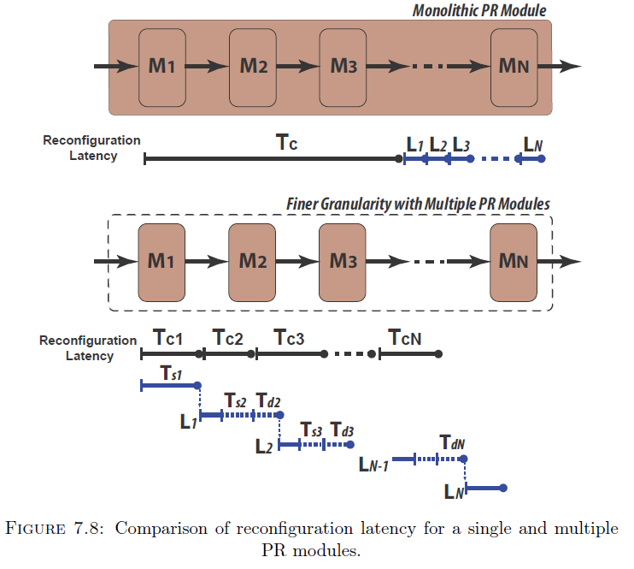
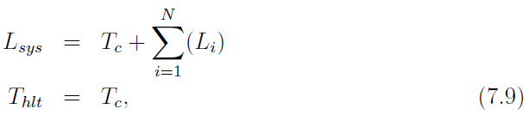
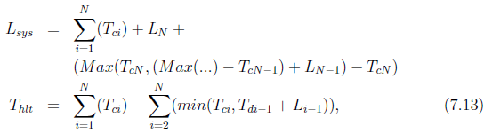
Architecture for Multi-Standard CRs
Latency and Stalling for PR-Based Baseband
Large monolithic PR module
Multiple finer PR modules
Tc : Reconfiguration time
Li : Computation latency of the ith module
Ts : Stalling time. Subsequence module is busy
Td: Delay time. Subsequence module have to wait for data
Notes:
We present an analysis model for computing reconfiguration time shown in the figure.
We consider a system consisting of N modules. These are the parameters be considered.
Explain Diagram …
Note that received data can be processed during the computation latency and a module can not process data during its reconfiguration time.
During system stalling time, it would require a FIFO to buffer received data which would otherwise be lost.

Slide 47
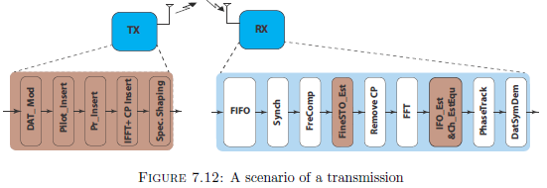
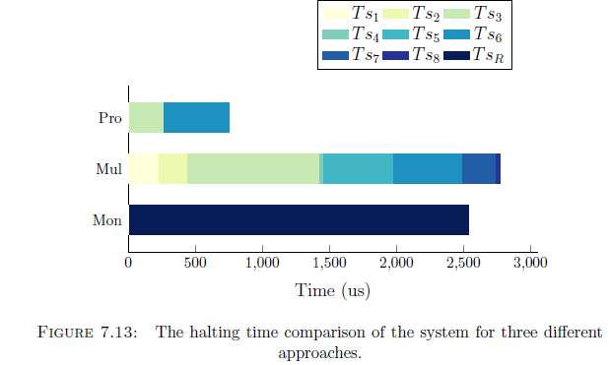
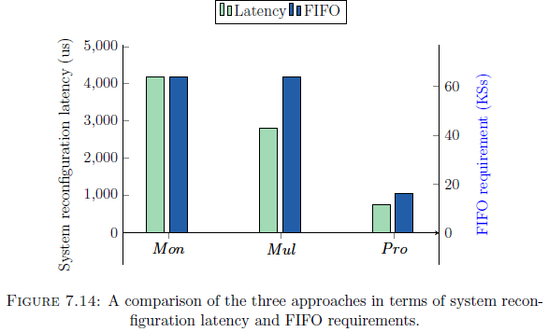
Architecture for Multi-Standard CRs
Analysing the Proposed OFDM MSCR Approach
Mon, Mul, Pro denote monolithic PR, Multiple PR, Proposed method
T_{sn} : Stalling time of M_{n} module
T_{sR} : Stalling time of monolithic receiver
Notes:
We investigate the performance of the three approaches.
Explain chart 7.13…
The proposed method significantly reduce the halting time.
The halting time is caused by the reconfiguration of Fine STO and IFO estimation PR modules.
Figure 7.13 compares the three approaches in terms of system reconfiguration latency (respect to the left axis) and FIFO buffering requirements (respect to the left axis) .
The system reconfiguration latency of the proposed method is significantly reduced in comparison to the monolithic PR module and the multiple PR module approaches.
The FIFO requirement for the proposed approach is only 16 KSs while the other approaches require a FIFO to store up to 64 KSs.

Slide 48
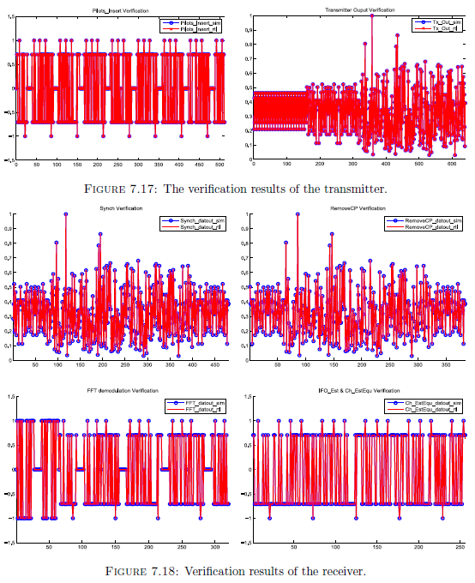
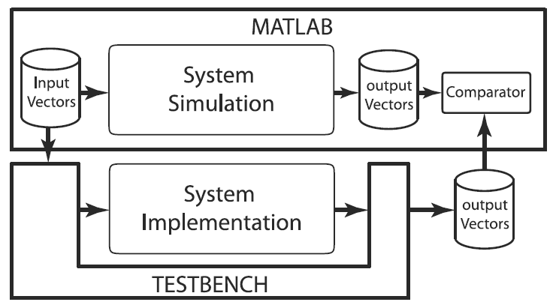
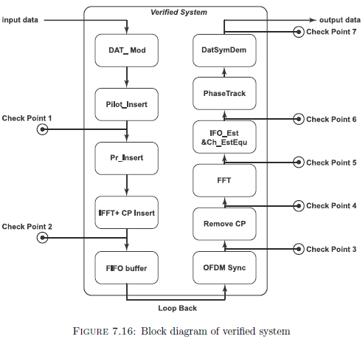
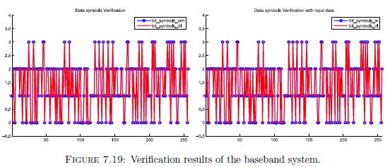
Architecture for Multi-Standard CRs
System Verification
Notes:
Explain platform …
The figures on the left hand side shown the verification of the implemented system.
The figures on the right hand side report the comparison of the input, output signals and intermediate signal between the implementation and referent simulation.
The identical samples verifies the correctness of implementation.

Slide 49
Architecture for Multi-Standard CRs
An efficient FPGA-based architecture for MSCRs
Mixing parameterisation and PR => more efficient in terms of time, and buffering requirements
Overall halting time is reduced by more than half;
FIFO requirement of the proposed method is decreased to 25 %
Presented at FPL 2014 and
prepared for ACM Transactions on Embedded Computing Systems
Notes:
This contribution presents an efficient FPGA-based architecture for MSCRs
We have shown that configuring a radio baseband composed of multiple modules can be made more efficient in terms of time, and buffering requirements, by mixing parameterisation and PR.
As a result, overall halting time is reduced by more than half. The FIFO buffering requirement of the proposed method is also decreased to 25 % of that required for the other methods.
This work is presented in FPL 2014 and preparing for ACM Transactions on Embedded Computing Systems

Slide 50
OUTLINE
Research Introduction
Background Literature
Research Contributions
Conclusions and Future Work

Slide 51
Conclusion
Low power, Robust, Efficient Synchronisation
An Architecture for IFO Estimation to Enhance Sync.
OFDM Spectrum Shaping based on CR Architecture
Multi-Standard Cognitive Radio Design
Notes:
This thesis has presented techniques for implementing robust, low-power multi-standard cognitive radios using modern FPGAs.
We looked at …
We looked at …
We looked at …
We looked at …

Slide 52

Future Direction
Increase Spectrum Efficiency with Shaping for NC-OFDM
Efficiently Adaptive Shaping Spectral Leakage
Standardised Software Interface for Multi-Standard
Radio Platform
Alternative Multi-Carrier Modulations Techniques
Higher Layer Knowledge to Minimise Reconfig. Time
Notes:
Our achievements in this thesis have helped us identify crucial questions to be explored in future along this line.
We have some ideas listed here for future works.

Slide 53

THANK YOU!

